Slide 1

Hostel Management System
Banda Singh Bahadur Boys Hostel
University College of Engineering
Punjabi University, Patiala
Pranav Jindal
11101157

Slide 2
Overview of Hostel Management
The software aims the computerization of hostel management letting the complete process of allotment and its management be dependent on computer.
As the working of any hostel is almost same, I’ve chosen our very own “Banda Singh Bahadur Boys Hostel” to present the software and its design.
The hostel consists of three blocks A, B and C. There is a head clerk who maintains the complete database of students, maintains the room allotments and the payment of bills.
  For mess, there are three accountants for each block who maintain the daily mess charges for each student.
Without computers, everything goes on registers causing a lot of paper work with very less efficiency, which is where this software can dramatically improve the overall management.

Slide 3
Technologies Implemented
Technologies Implemented:
The computer technologies used to design and code the software.
Java SE
The standard edition of Java is the base technology behind the project. Netbeans 7.3.1 IDE was used to code the software.
JavaFX
JavaFX was used to design the graphical user interface with the help JavaFX Scene Builder 1.0.
MySQL Database
The back-end database being used is MySQL Server 5.0 which has been used to store all the hostel information.

Slide 4
Software Design
Design
The design of software using the computer technologies.
User Interface Design
The User interface design includes the graphical part of program that deals with the user activities and acts as an interface between the application program and the user.
JavaFX was the key technology that helped making a user friendly and easy to use software.
Logical Design
This is the part of software design that deals with the events that are made by user using the UI, which is where the core code of program comes into action.
Java and MySQL Database in combination are the key technologies used to handle the logic of the software.

Slide 5
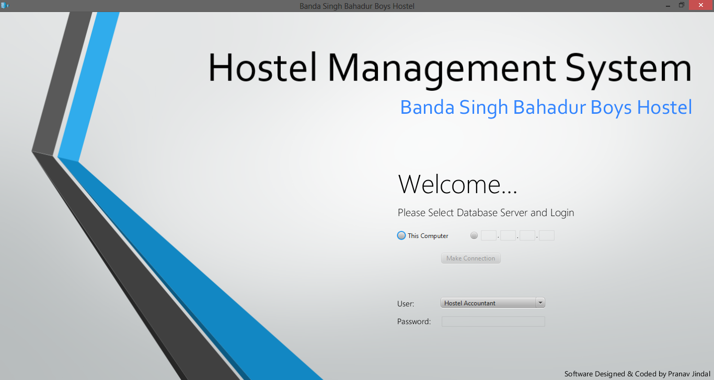
User Interface Design
The user interface is the graphical part of program that deals with the user’s activities and provides a user friendly environment to work on without need of too much learning before use.
Select Database
Select User
Enter Password
The first and the main window of the software expects user to first help it making the connection with the database.
After the connection is successful, the user can login the respective account.
The database connection, user selection and their respective features have been described in the following slides.
Main Program Window

Slide 7
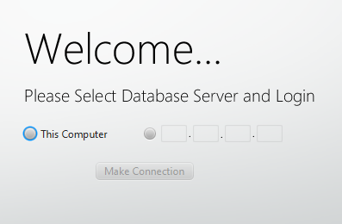
Database Selection
Database Location
The software provides two options to select database location.
Server over Local Machine
If the server is on local machine, user can select the first radio button.
Server over Network
If the server is over network, user just need to fill up the IP address of server machine to make connection.
Database Selection Screen

Slide 8
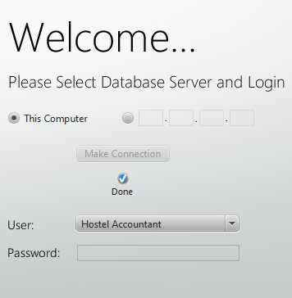
User Selection and Login
Users
These are the users that can log into the software.
Hostel Accountant
This is the main clerk who handles all the allotment.
A Block Accountant
This is the accountant of the mess for A block who keeps the record of mess charges for each room number.
B Block Accountant
This is the accountant of the mess for B block who keeps the record of mess charges for each room number.
C Block Accountant
This is the accountant of the mess for C block who keeps the record of mess charges for each room number.
User Selection after Database Connection

Slide 9
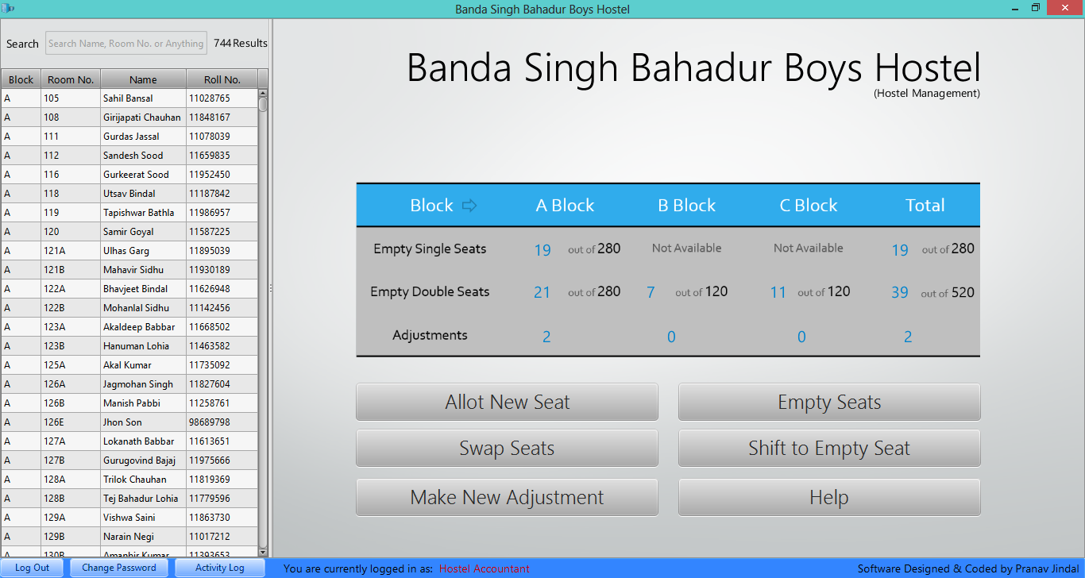
Hostel Accountant
This user account is meant for the head clerk who maintains the complete database of students, maintains the room allotments and the payment of bills.
Activities:
The activities the head clerk can do.
Allot a new room
Empty an allotted room
Swap rooms between students
Shift student to empty room
Make an adjustment
Update Details of student
Receive Payments of Mess Bill
Head Clerk Account

Slide 11
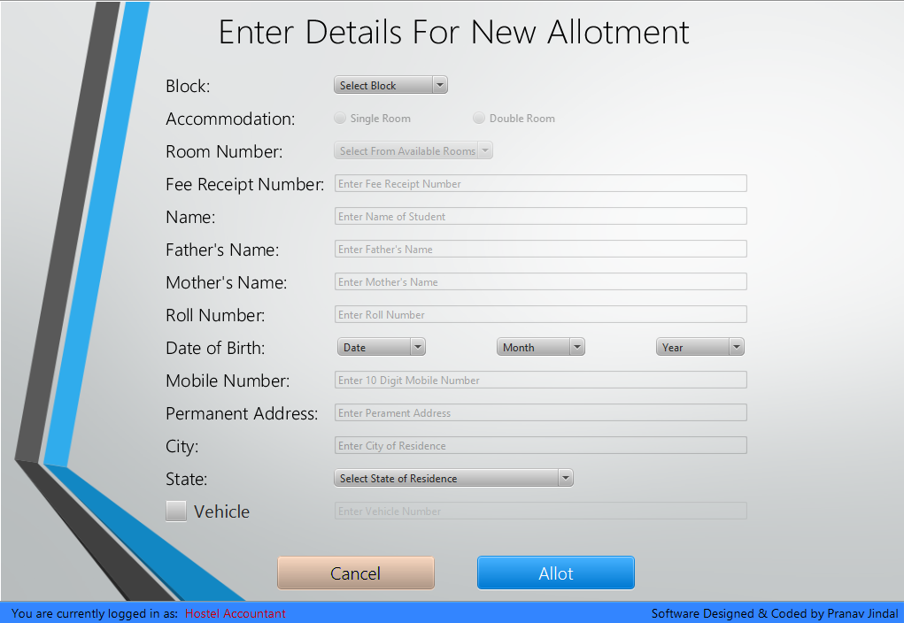
Allot New Room
Clerk can allot a new seat to a student using this action button clicking on which opens up the form to allot new room.
The form expects user to select the block and room number to allot through a combo box which shows the list of empty rooms only.
The room can be allotted only when the valid details are filled. For example:
Mobile number needs to be a 10 digit number.
Date should be a valid one.
Roll No., Vehicle No. and Fee receipt number should be unique.

Slide 12
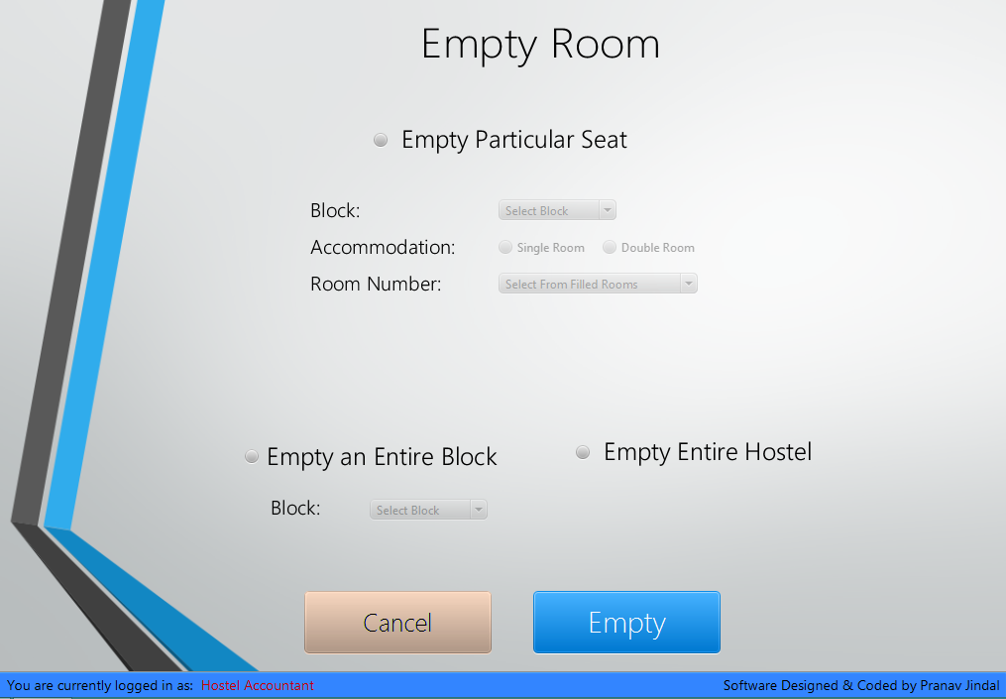
Empty Room
This allows admin to empty some particular seat, or the entire block or the entire hostel.
The form expects user to select radio button of the action to be performed.
Further selecting the Block or Room No. as per the radio button selected.
The room can be emptied only when there is no mess bill pending for the room.

Slide 13
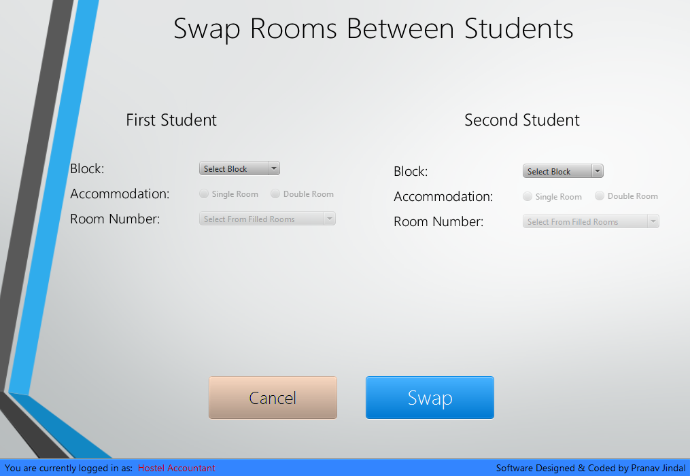
Swap Rooms
This allows admin to swap seats between students letting the complex process of information interchange be done by computer itself.
The form expects user to select the two students and simply press the swap button to do rest of the job.
The pending mess bill also goes along with the students.

Slide 14
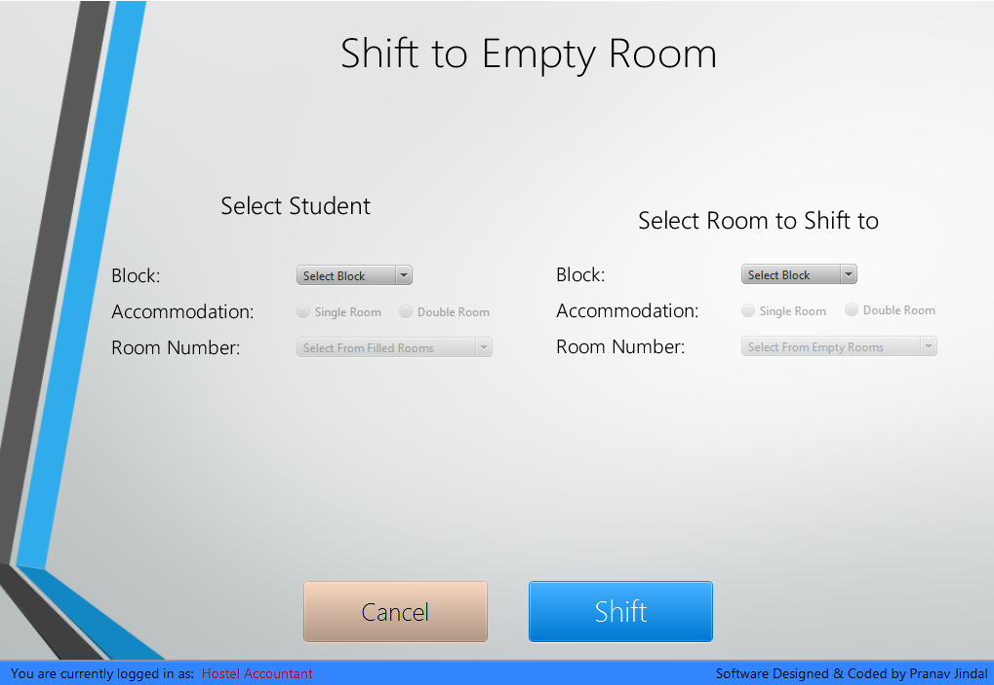
Shift to Empty Room
This allows admin to shift a student to an empty seat in the hostel.
The form expects user to select the student to shift and the available empty room to which student is to be shifted and pressing the shift button shifts the student to the room.
The pending mess bill also goes along with the student.

Slide 15
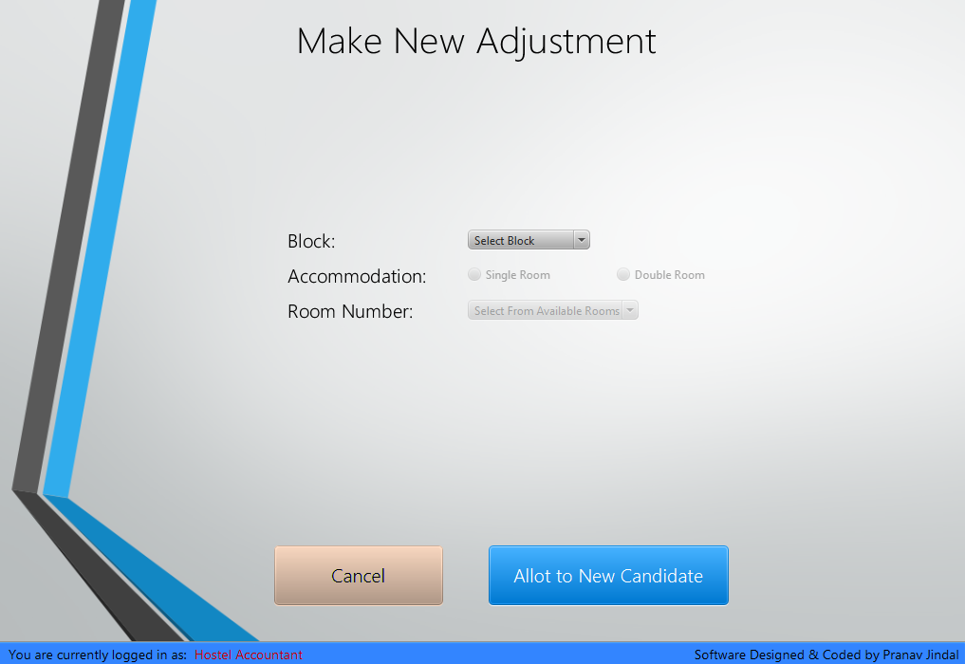
Make New Adjustment
This allows admin to make some adjustment in some room. Only one student can be adjusted in one single room.
The form expects user to select the room into which the adjustment is to be made, and the seat allotted to becomes the room number suffixed with letter “E”.
The rest of the adjustment process is same as the allotment.

Slide 16
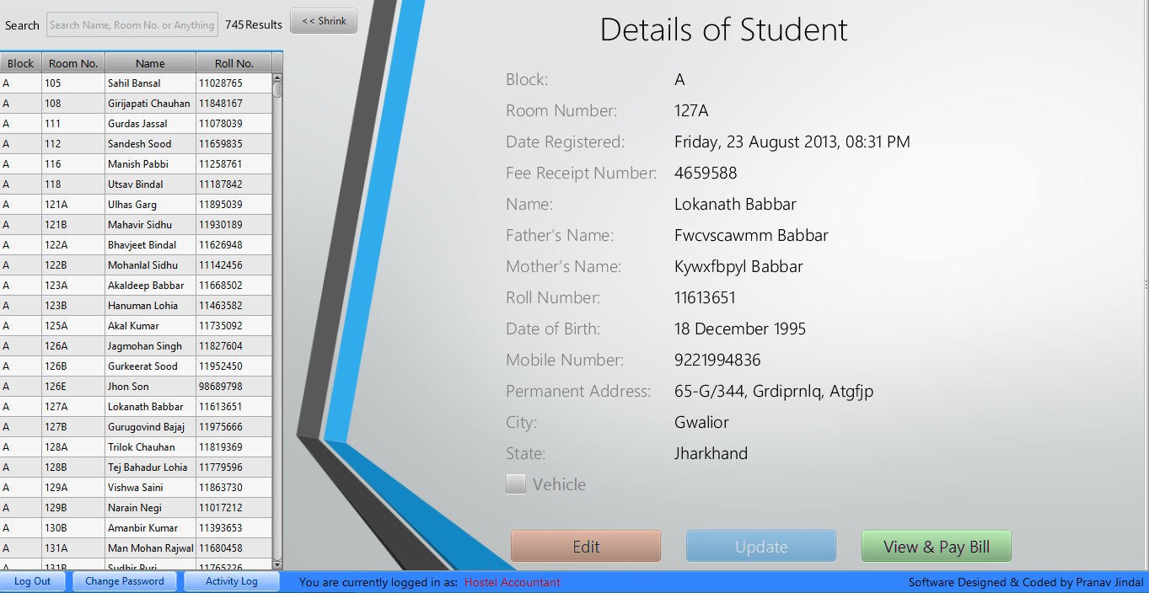
View & update Student Details
This allows admin to update details of student.
The form expects user to select the student from the left table which shows the students according to search box.
As soon as user selects the student, the pane slides to right and clicking on update button will allow updating details.

Slide 17
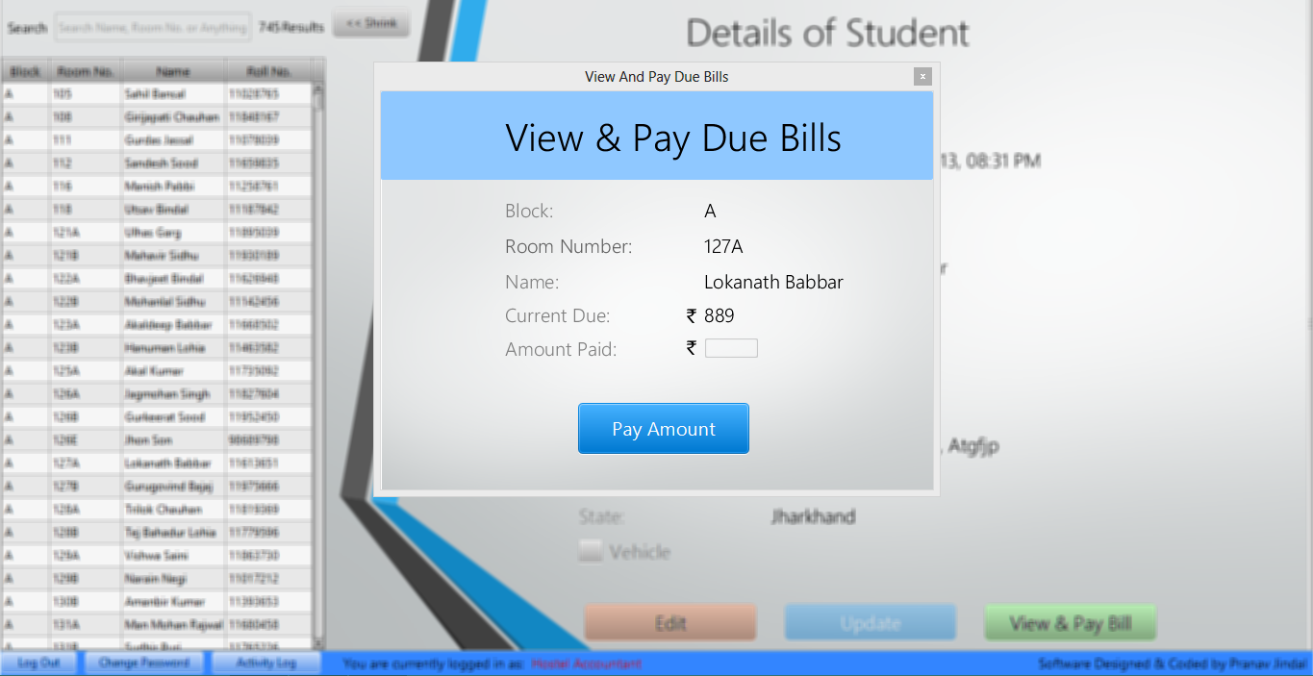
Paying Mess Bill
This allows admin to receive payments of mess bill of any student.
The student can be searched and click to open details page which has an option to pay pending bill clicking on which will open up the dialog box for the same.
Simply enter the amount, change will be adjusted next time.

Slide 18
Accessibility Features
Various features are provided to the head clerk page to provide ease of access to every activity user wants do.
Accessibility features:
Unified Search Box
This is an all in one Search Engine for the complete database of hostel in which the results are searched out as you type, no matter what you type.
Activity Log
This is the activity logger that keeps records of all the activity the user has ever done along with the timestamp at which it was accomplished.
Change Password
This feature is a simple password changing window which can be instantiated at any time.
Information Table
This table is visible on the main page of head clerk which shows the stats of single, double seats and adjustments in the hostel.

Slide 19
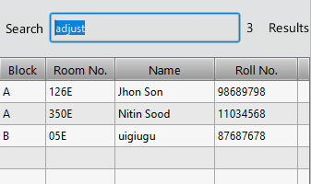
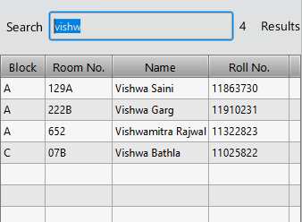
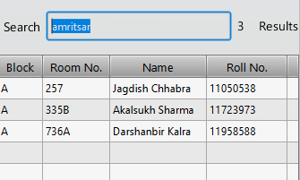
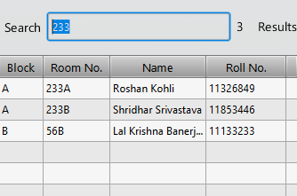
Unified Search Box
This is an all in one Search Engine for the complete database of hostel which lets you search students as you type.
You can search by Name of student, Roll Number, Room Number, City, State, Vehicle Number. The results will be searched out as you type.
Two Keywords lets you shortlist students:
“adjust” shows the students who are adjusted.
“pending” shows the students who have some bill pending.

Slide 20
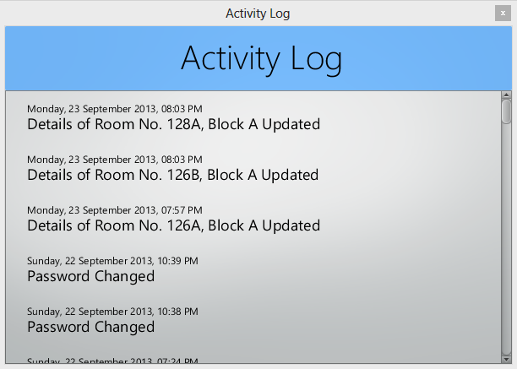
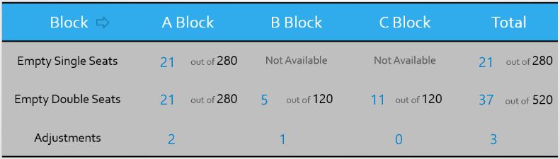
Activity Log & Information Table
The Activity Log is the activity logger that keeps records of all the activity the user has ever done along with the timestamp at which it was accomplished.
The logger keeps a record of every activity of user such as allotment, swapping, shifting, updating, billing, etc. along with the timestamp.
The Information table is visible on the main page of head clerk which shows the empty/total seats of single, double rooms and adjustments in the hostel.

Slide 21
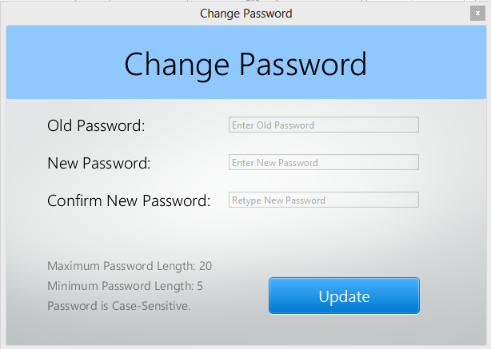
Change Password
This dialog box lets you change the password of the user.
The form expects user to fill up the old password, and the new one twice.
Conditions:
Maximum Password Length is 20.
Minimum Password Length is 5.
Password is Case-Sensitive.

Slide 22
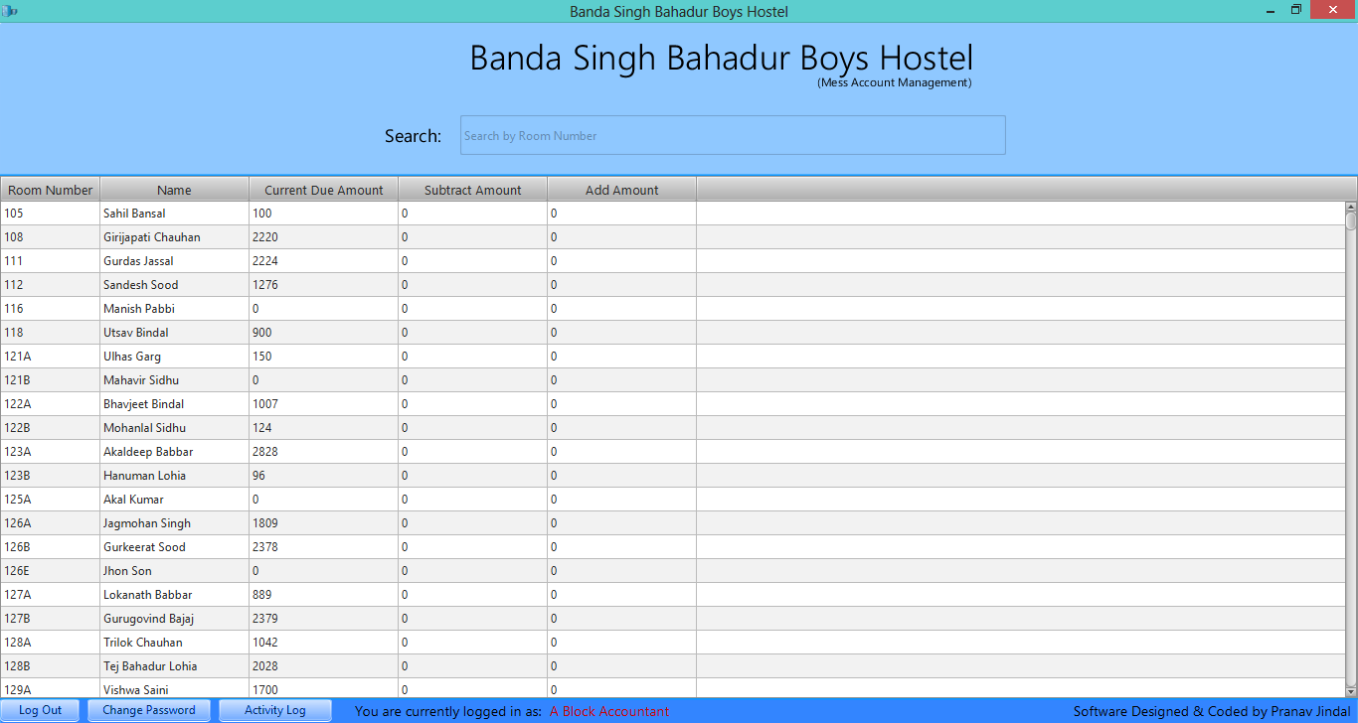
Mess Accountants
These user accounts are meant for the mess accountants who keep the record of mess charges for each room number.
Activities:
The activities the mess accountant can do.
Add amount
The accountant can add amount to any room on daily basis.
Subtract Amount
The accountant can subtract any amount if accidently he adds extra amount or whatever the reason be.
Accessibility features:
Search Box
This is a search box that lets user shortlist the table by searching room number.
Activity Log
Same as previous.
Change Password
Same as previous.

Slide 24
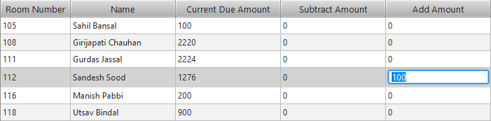
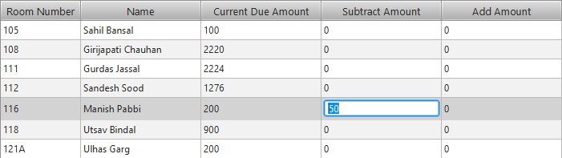
Adding & Subtracting Amount
The mess accountant can simply add amount in the add column to any room, and similarly subtract some amount.
Adding amount
The form expects user to select the student and press enter in subsequent column which changes the cell to textbox and hence letting the user to add/subtract amount.
Subtracting amount

Slide 25

Logical Design
Host Operating System
Java Application
Database Server
Java Virtual Machine (JVM)
Java application does not run directly on the host operating system but over a virtual machine called Java Virtual Machine(JVM) created by Java Runtime Environment (JRE).
A Block Mess Accountant
B Block Mess Accountant
The program has been designed in such a way that the actual database is stored on the head clerk’s machine and rest of the accountants connect to the database via a local network.
Local Area Network
Switch
C Block Mess Accountant
Database server on Admin System
IP x.x.x.x

Slide 26
Database Design
The Database of hostel consists of three tables described as follows:
This is the table that contains each and every detail of every available room in any of the block of hostel.
Rooms
Admin
This is the table that keeps record of users and passwords.
HostelDB
This is the table that is used to log each and every activity of every user for the Activity Log.
Activity

Slide 27
Rooms Table
rooms
block
roomno
doubleroom
filled
adjusted
datemodified
feeno
name
father
mother
rollno
dob
mobile
address
city
state
vehicle
vehicleno
due
This table is the main table that is used to maintain the details of every available room.
Block and Roomno are the COMPOSITE KEY (Primary Key in combination),
There are few extra attributes other than that are required to fill up student
detail which are used to keep track of mandatory parameters.
For example:
Filled is used to determine whether room is empty or filled.
Adjusted determines whether seat is adjusted and so on..

Slide 28
Activity & Admin Table
activity
admin
time
string
This is the table that is used to log each and every activity of every user for the Activity Log.
admin column is used for the user of which activity is being logged.
time is timestamp default value of which is current_time.
string is varchar used to store the actual activity.
admin
user
pass
This is the table that keeps record of users and passwords.
user column is varchar for username.
pass column is varchar for password for each user.

Slide 29
Thank You!

